Slide 1
William Stallings
Data and Computer Communications
7th Edition
Chapter 13
Congestion in Data Networks

Slide 2
What Is Congestion?
Congestion occurs when the number of packets being transmitted through the network approaches the packet handling capacity of the network
Congestion control aims to keep number of packets below level at which performance falls off dramatically
Data network is a network of queues
Generally 80% utilization is critical
Finite queues mean data may be lost

Slide 3
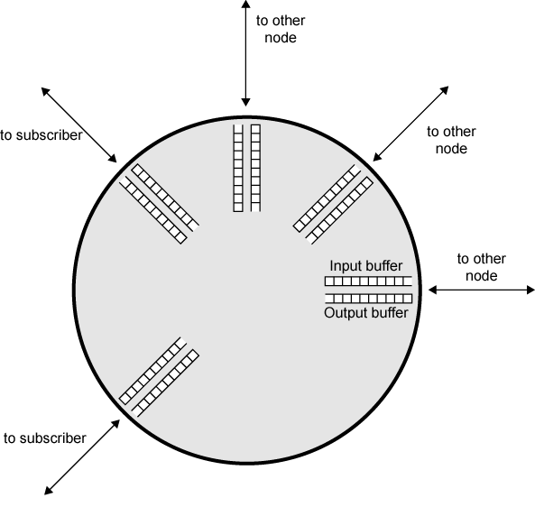
Queues at a Node

Slide 4
Effects of Congestion
Packets arriving are stored at input buffers
Routing decision made
Packet moves to output buffer
Packets queued for output transmitted as fast as possible
  Statistical time division multiplexing
If packets arrive to fast to be routed, or to be output, buffers will fill
Can discard packets
Can use flow control
  Can propagate congestion through network

Slide 5
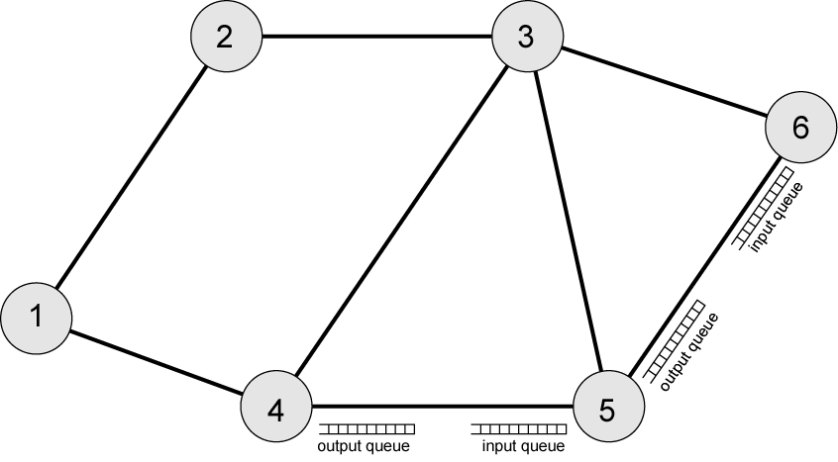
Interaction of Queues

Slide 6
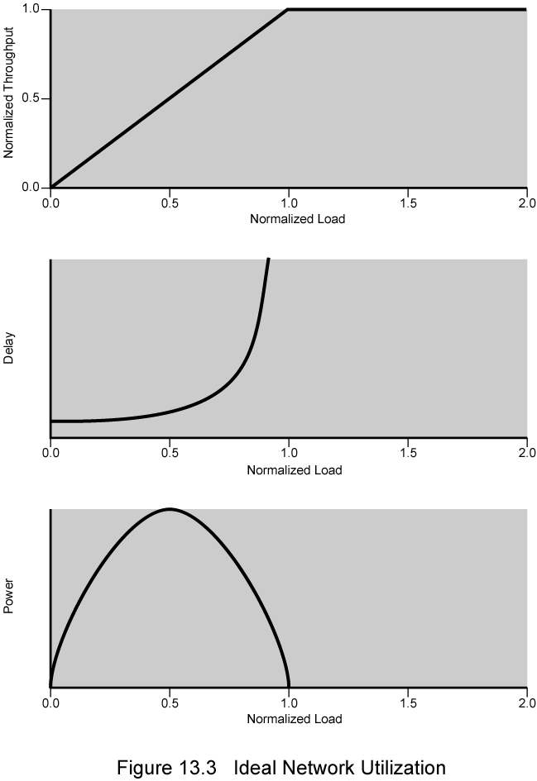
Ideal
Network
Utilization

Slide 7
Practical Performance
Ideal assumes infinite buffers and no overhead
Buffers are finite
Overheads occur in exchanging congestion control messages

Slide 8
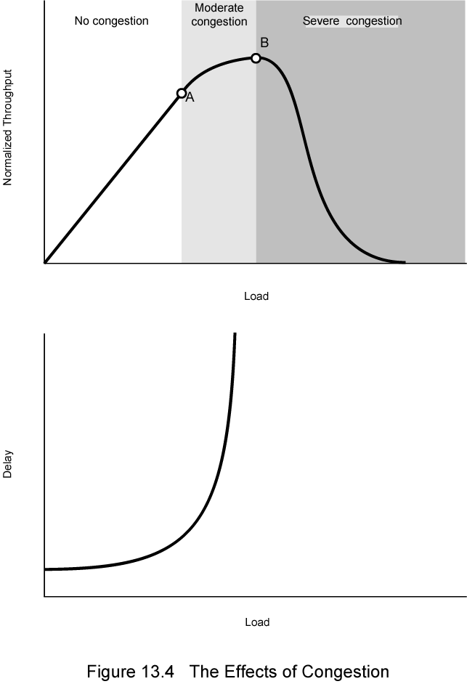
Effects of
Congestion -
No Control

Slide 9
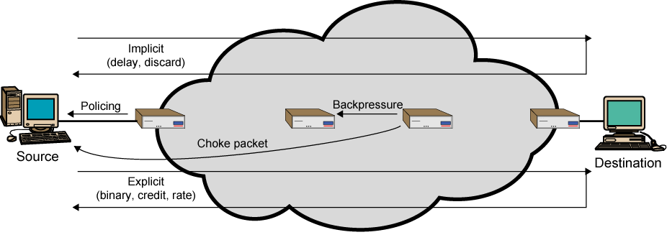
Mechanisms for
Congestion Control

Slide 10
Backpressure
If node becomes congested it can slow down or halt flow of packets from other nodes
May mean that other nodes have to apply control on incoming packet rates
Propagates back to source
Can restrict to logical connections generating most traffic
Used in connection oriented that allow hop by hop congestion control (e.g. X.25)
Not used in ATM nor frame relay
Only recently developed for IP

Slide 11
Choke Packet
Control packet
  Generated at congested node
  Sent to source node
  e.g. ICMP source quench
    From router or destination
    Source cuts back until no more source quench message
    Sent for every discarded packet, or anticipated
Rather crude mechanism

Slide 12
Implicit Congestion Signaling
Transmission delay may increase with congestion
Packet may be discarded
Source can detect these as implicit indications of congestion
Useful on connectionless (datagram) networks
  e.g. IP based
    (TCP includes congestion and flow control - see chapter 17)
Used in frame relay LAPF

Slide 13
Explicit Congestion Signaling
Network alerts end systems of increasing congestion
End systems take steps to reduce offered load
Backwards
  Congestion avoidance in opposite direction to packet required
Forwards
  Congestion avoidance in same direction as packet required

Slide 14
Categories of Explicit Signaling
Binary
  A bit set in a packet indicates congestion
Credit based
  Indicates how many packets source may send
  Common for end to end flow control
Rate based
  Supply explicit data rate limit
  e.g. ATM

Slide 15
Traffic Management
Fairness
Quality of service
  May want different treatment for different connections
Reservations
  e.g. ATM
  Traffic contract between user and network

Slide 16
Congestion Control in Packet Switched Networks
Send control packet to some or all source nodes
  Requires additional traffic during congestion
Rely on routing information
  May react too quickly
End to end probe packets
  Adds to overhead
Add congestion info to packets as they cross nodes
  Either backwards or forwards

Slide 17
Frame Relay
Congestion Control
Minimize discards
Maintain agreed QoS
Minimize probability of one end user monoply
Simple to implement
  Little overhead on network or user
Create minimal additional traffic
Distribute resources fairly
Limit spread of congestion
Operate effectively regardless of traffic flow
Minimum impact on other systems
Minimize variance in QoS

Slide 18
Techniques
Discard strategy
Congestion avoidance
Explicit signaling
Congestion recovery
Implicit signaling mechanism

Slide 19
Traffic Rate Management
Must discard frames to cope with congestion
  Arbitrarily, no regard for source
  No reward for restraint so end systems transmit as fast as possible
  Committed information rate (CIR)
    Data in excess of this liable to discard
    Not guaranteed
    Aggregate CIR should not exceed physical data rate
Committed burst size
Excess burst size

Slide 20
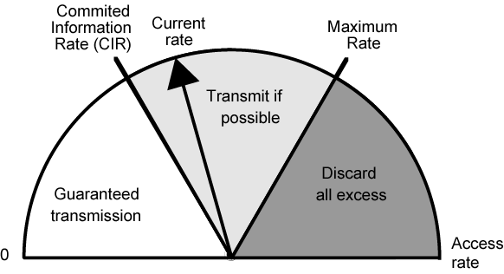
Operation of CIR

Slide 21
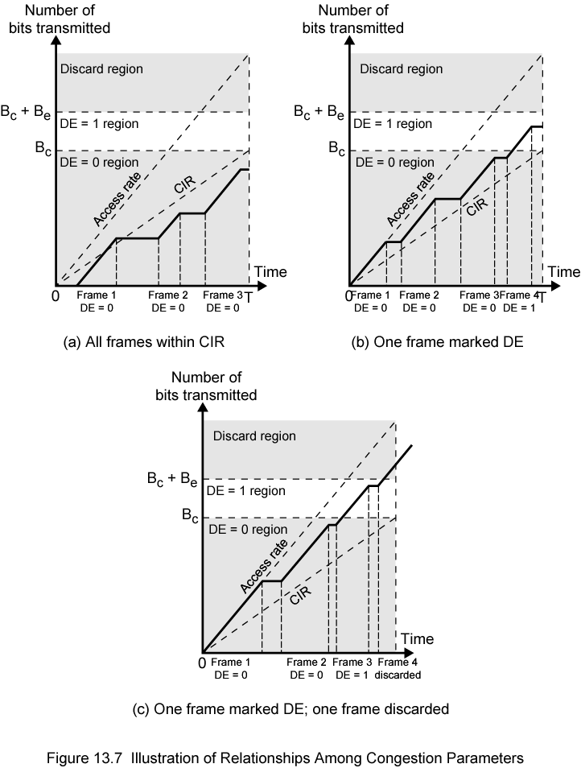
Relationship
Among
Congestion
Parameters

Slide 22
Explicit Signaling
Network alerts end systems of growing congestion
Backward explicit congestion notification
Forward explicit congestion notification
Frame handler monitors its queues
May notify some or all logical connections
User response
  Reduce rate

Slide 23
ATM Traffic Management
High speed, small cell size, limited overhead bits
Still evolving
Requirements
  Majority of traffic not amenable to flow control
  Feedback slow due to reduced transmission time compared with propagation delay
  Wide range of application demands
  Different traffic patterns
  Different network services
  High speed switching and transmission increases volatility

Slide 24
Latency/Speed Effects
ATM 150Mbps
~2.8x10⁻⁶ seconds to insert single cell
Time to traverse network depends on propagation delay, switching delay
Assume propagation at two-thirds speed of light
If source and destination on opposite sides of USA, propagation time ~ 48x10⁻³ seconds
Given implicit congestion control, by the time dropped cell notification has reached source, 7.2x10⁶ bits have been transmitted
So, this is not a good strategy for ATM

Slide 25
Cell Delay Variation
For ATM voice/video, data is a stream of cells
Delay across network must be short
Rate of delivery must be constant
There will always be some variation in transit
Delay cell delivery to application so that constant bit rate can be maintained to application

Slide 26
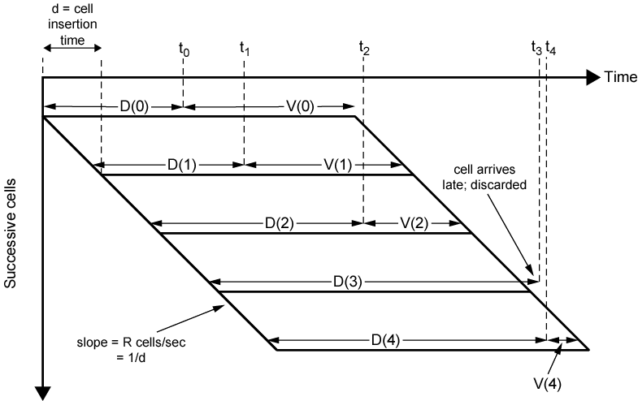
Time Re-assembly of CBR Cells

Slide 27
Network Contribution to
Cell Delay Variation
Packet switched networks
  Queuing delays
  Routing decision time
Frame relay
  As above but to lesser extent
ATM
  Less than frame relay
  ATM protocol designed to minimize processing overheads at switches
  ATM switches have very high throughput
  Only noticeable delay is from congestion
  Must not accept load that causes congestion

Slide 28
Cell Delay Variation
At The UNI
Application produces data at fixed rate
Processing at three layers of ATM causes delay
  Interleaving cells from different connections
  Operation and maintenance cell interleaving
  If using synchronous digital hierarchy frames, these are inserted at physical layer
  Can not predict these delays

Slide 29
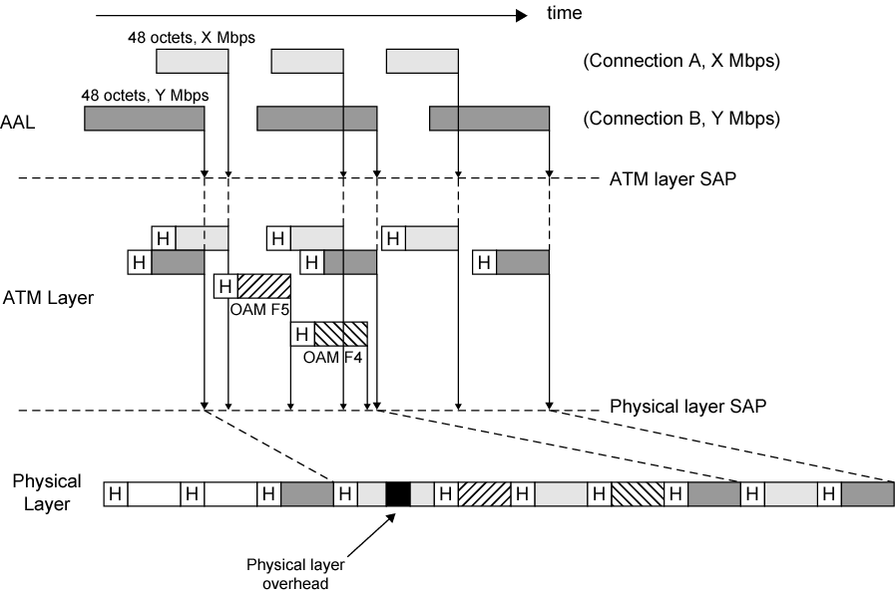
Origins of Cell Delay Variation

Slide 30
Traffic and Congestion
Control Framework
ATM layer traffic and congestion control should support QoS classes for all foreseeable network services
Should not rely on AAL protocols that are network specific, nor higher level application specific protocols
Should minimize network and end to end system complexity

Slide 31
Timings Considered
Cell insertion time
Round trip propagation time
Connection duration
Long term
Determine whether a given new connection can be accommodated
Agree performance parameters with subscriber

Slide 32
Traffic Management and Congestion Control Techniques
Resource management using virtual paths
Connection admission control
Usage parameter control
Selective cell discard
Traffic shaping

Slide 33
Resource Management Using Virtual Paths
Separate traffic flow according to service characteristics
User to user application
User to network application
Network to network application
Concern with:
  Cell loss ratio
  Cell transfer delay
  Cell delay variation

Slide 34
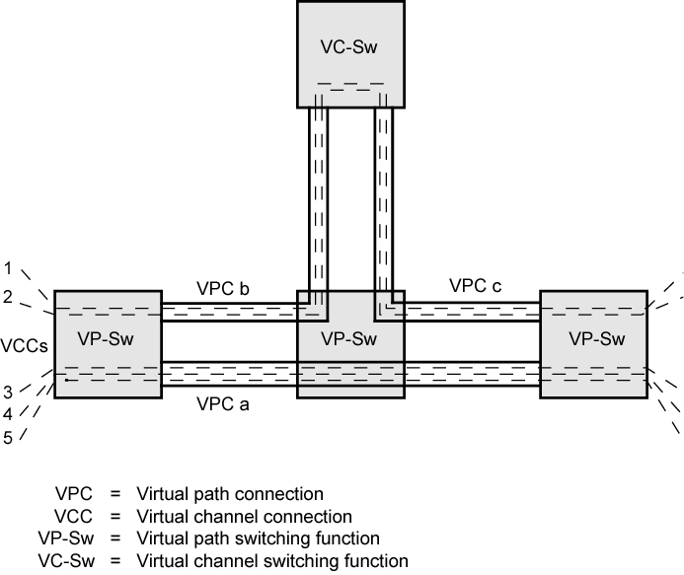
Configuration of
VCCs and VPCs

Slide 35
Allocating VCCs within VPC
All VCCs within VPC should experience similar network performance
Options for allocation:
  Aggregate peak demand
  Statistical multiplexing

Slide 36
Connection Admission Control
First line of defense
User specifies traffic characteristics for new connection (VCC or VPC) by selecting a QoS
Network accepts connection only if it can meet the demand
Traffic contract
  Peak cell rate
  Cell delay variation
  Sustainable cell rate
  Burst tolerance

Slide 37
Usage Parameter Control
Monitor connection to ensure traffic cinforms to contract
Protection of network resources from overload by one connection
Done on VCC and VPC
Peak cell rate and cell delay variation
Sustainable cell rate and burst tolerance
Discard cells that do not conform to traffic contract
Called traffic policing

Slide 38
Traffic Shaping
Smooth out traffic flow and reduce cell clumping
Token bucket

Slide 39
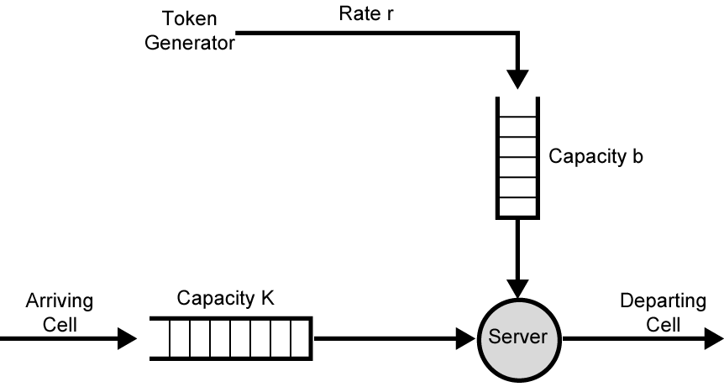
Token Bucket for
Traffic Shaping

Slide 40
GFR Traffic Management
Guaranteed frame rate is as simple as UBR from end system viewpoint
Places modest requirements on ATM network elements
End system does no policing or shaping of traffic
May transmit at line rate of ATM adaptor
No guarantee of delivery
  Higher layer (e.g. TCP) must do congestion control
User can reserve capacity for each VC
  Assures application may transmit at minimum rate without losses
  If no congestion, higher rates maybe used

Slide 41
Frame Recognition
GFR recognizes frames as well as cells
When congested, network discards whole frame rather than individual cells
All cells of a frame have same CLP bit setting
CLP=1 AAL5 frames are lower priority
  Best efforts
CLP=0 frames minimum guaranteed capacity

Slide 42
GFR Contract Parameters
Peak cell rate (PCR)
Minimum cell rate (MCR)
Maximum burst size (MBS)
Maximum frame size (MFS)
Cell delay variation tolerance (CDVT)

Slide 43
Mechanisms for Supporting Rate Guarantees (1)
Tagging and policing
  Discriminate between frames that conform to contract and those that don’t
  Set CLP=1 on all cells in frame if not
    Gives lower priority
  Maybe done by network or source
  Network may discard CLP=1 cells
    Policing
Buffer management
  Treatment of buffered cells
  Congestion indicated by high buffer occupancy
  Discard tagged cells
    Including ones already in buffer to make room
  To be fair, per VC buffering
  Cell discard based on queue-specific thresholds

Slide 44
Mechanisms for Supporting Rate Guarantees (2)
Scheduling
  Give preferential treatment to untagged cells
  Separate queues for each VC
  Make per-VC scheduling decisions
  Enables control of outgoing rate of VCs
  VCs get fair capacity allocation
  Still meet contract

Slide 45
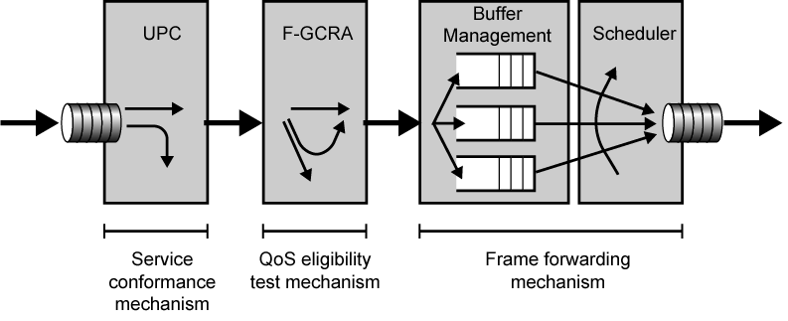
Components of GFR System

Slide 46
Conformance Definition
UPC
  Monitors each active VC
  Ensure traffic conforms to contract
  Tag or discard nonconforming cells
  Frame conforms if all cells conform
  Cell conforms if:
    Rate of cells within contract
    All cells in frame have same CLP
    Frame satisfies MFS parameter (check for last cell in frame or cell count < MFS)

Slide 47
QoS Eligibility Test
Two stage filtering process
  Frame tested for conformance to contract
    If not, may discard
    If not discarded, tag
    Sets upper bound
    Penalize cells above upper bound
    Implementations expected to attempt delivery of tagged cells
  Determine frames eligible for QoS guarantees
    Under GFR contract for VC
    Lower bound on traffic
    Frames making up traffic flow below threshold are eligible

Slide 48
GFR VC Frame Categories
Nonconforming frame
  Cells of this frame will be tagged or discarded
Conforming but ineligible frames
  Cells will receive a best-effort service
Conforming and eligible frames
  Cells will receive a guarantee of delivery

Slide 49
Required Reading
Stallings chapter 13

